Slide 1
Bootstrap And Bootstrap New Futere
SlideMake.com

Slide 2
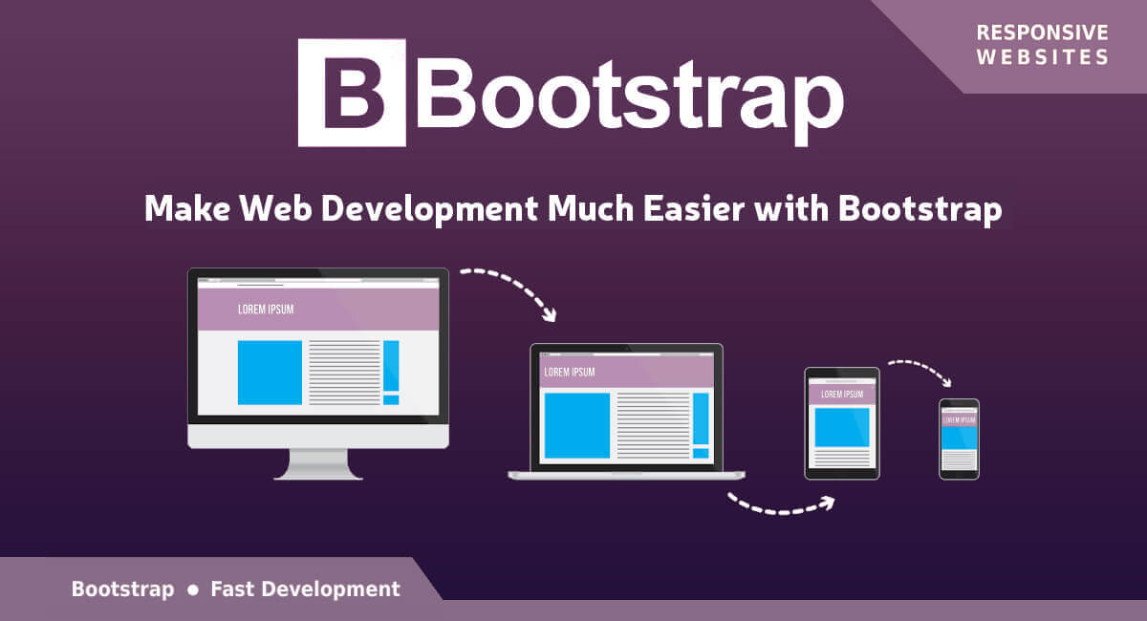
Introduction to Bootstrap
Bootstrap is a popular front-end framework for building responsive and mobile-first websites.
It includes CSS and JavaScript components for creating a consistent and visually appealing user interface.
Bootstrap's grid system allows for easy layout customization for different device sizes.
Notes:
Image source: http://vytcdc.com/bootstrap/

Slide 3
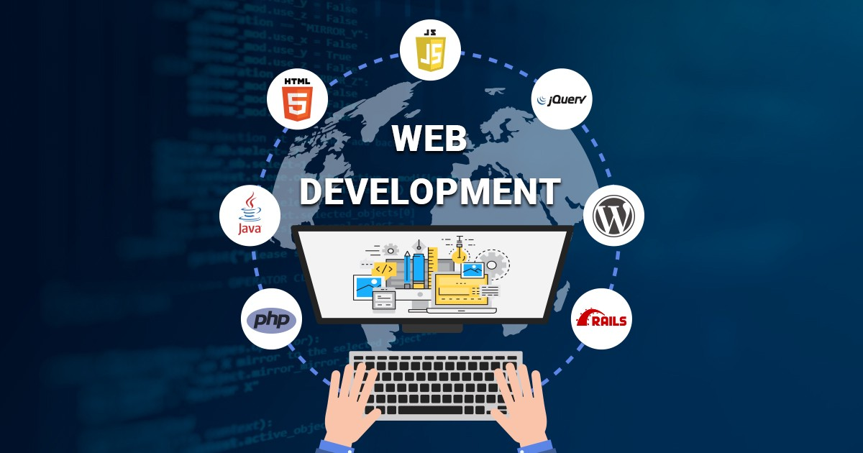
Advantages of Using Bootstrap
Saves time and effort in designing and coding responsive websites.
Provides a wide range of pre-built components and templates for faster development.
Offers good documentation and community support for troubleshooting and learning.
Notes:
Image source: https://www.dngwebdeveloper.in/know-about-bootstrap-in-web-development-and-how-it-is-useful/

Slide 4
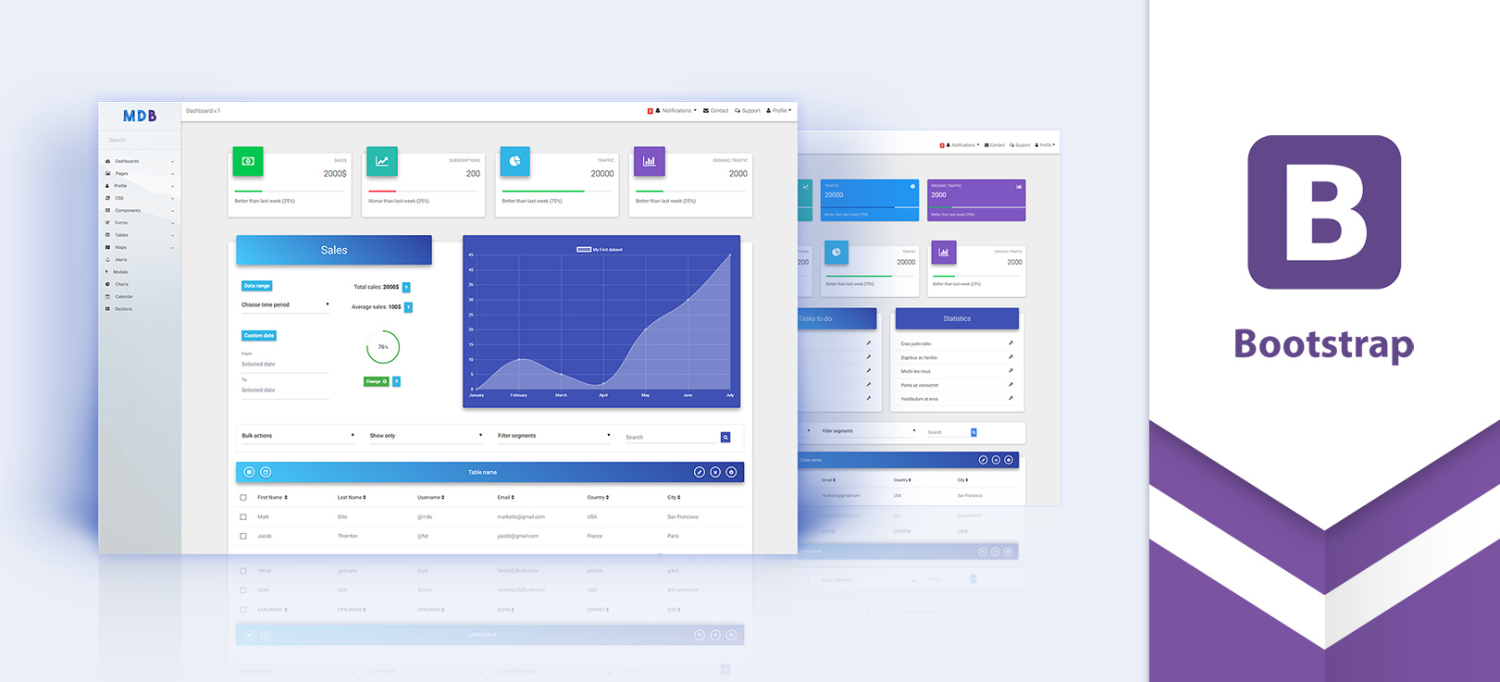
Key Features of Bootstrap
Responsive design ensures compatibility across various devices and screen sizes.
Customizable themes and components allow for easy branding and design consistency.
Built-in JavaScript plugins enhance interactivity and functionality without extra coding.
Notes:
Image source: https://browserlawpc.weebly.com/responsive-design-tutorial-bootstrap.html

Slide 5
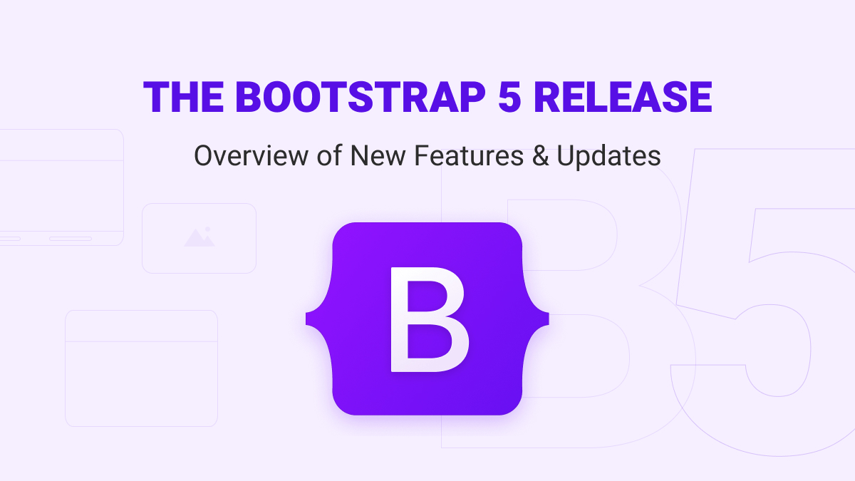
Bootstrap 5 Updates
Bootstrap 5 introduces a new utility API for easier customization and theming.
The removal of jQuery dependency makes Bootstrap 5 lighter and faster.
Enhanced grid system options provide more flexibility in layout design.
Notes:
Image source: https://zemez.io/bootstrap-5-release/

Slide 6
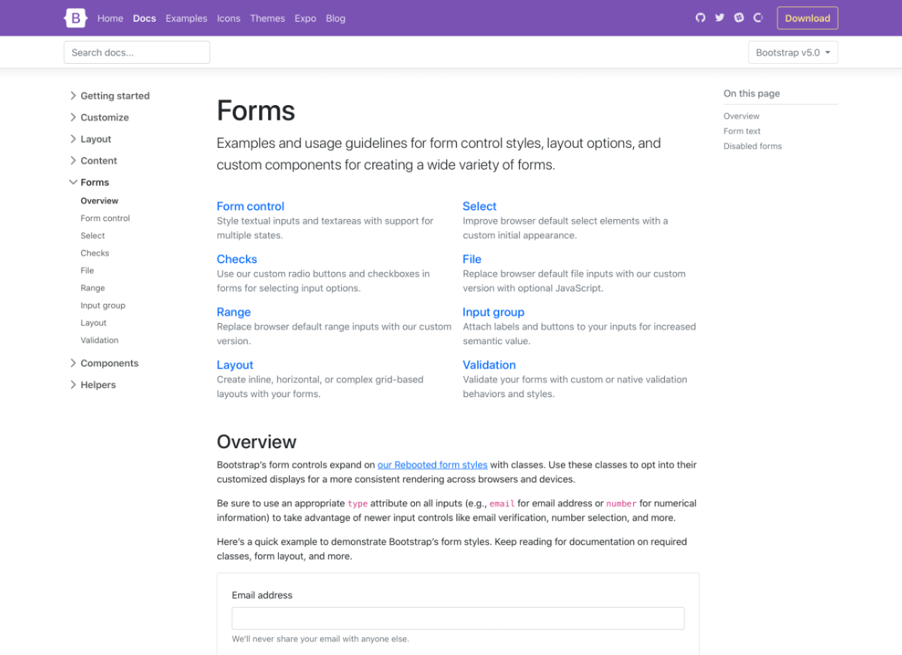
New Features in Bootstrap 5
Utility classes for spacing, typography, and colors offer more control over design elements.
Improved form controls and validation features enhance user input experiences.
Updates to the documentation and examples make it easier for developers to use Bootstrap.
Notes:
Image source: https://morioh.com/p/69db39b2413e

Slide 7
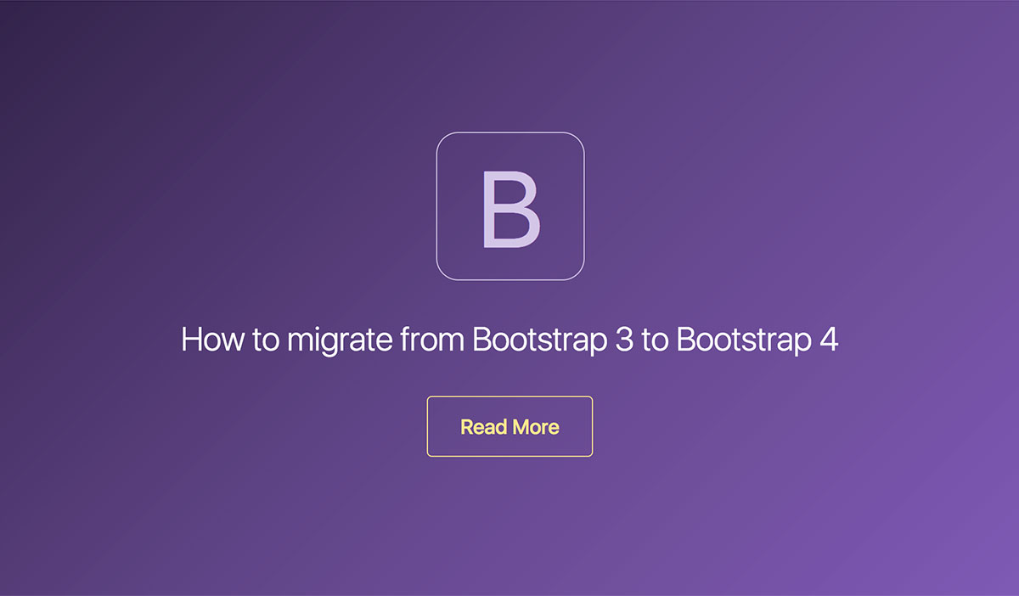
Migration to Bootstrap 5
Upgrading from Bootstrap 4 to Bootstrap 5 may require adjustments to custom code and dependencies.
The migration process involves updating class names and reviewing deprecated features.
Compatibility tools and guides are available to assist developers in transitioning to Bootstrap 5.
Notes:
Image source: https://coreui.io/blog/2018/01/31/migration-from-bootstrap-3-to-bootstrap-4/

Slide 8
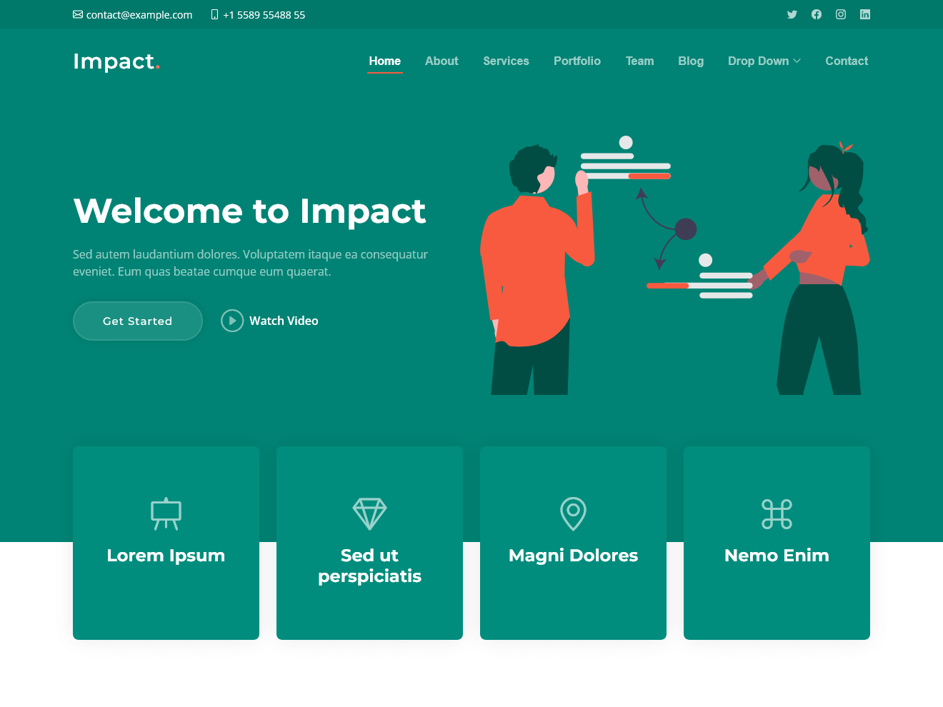
Bootstrap's Impact on Web Development
Bootstrap has revolutionized web development by providing a standardized framework for building modern websites.
Its popularity has led to a vast ecosystem of themes, templates, and plugins that extend its functionality.
Many businesses and developers rely on Bootstrap for its efficiency, scalability, and versatility.
Notes:
Image source: https://sitehtml.ru/impact-besplatnyj-shablon-bootstrap-5-dlya-agentstv-i-startapov/

Slide 9
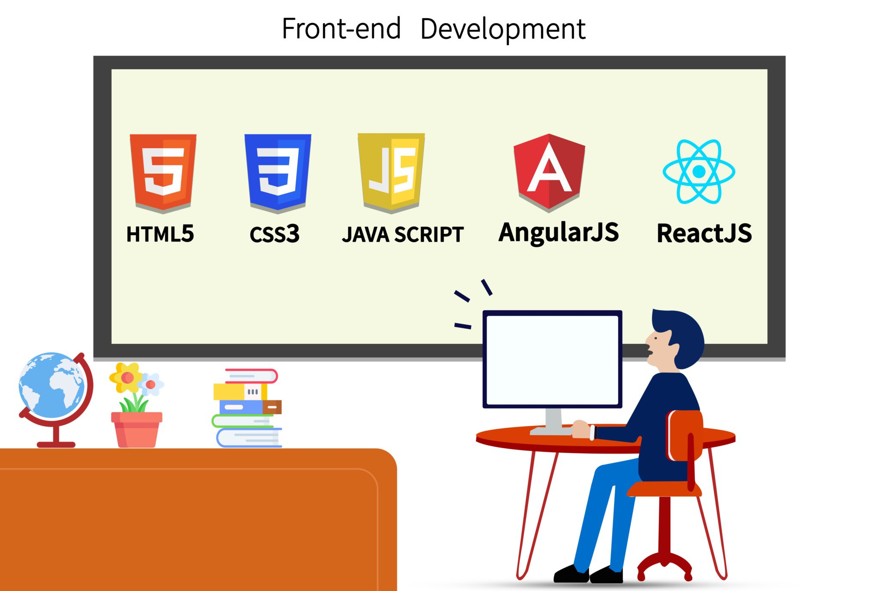
Future Trends in Front-End Development
The future of front-end development is likely to focus on performance optimization and accessibility.
Progressive web apps (PWAs) and serverless architecture are expected to influence web development practices.
Artificial intelligence (AI) and machine learning may play a larger role in automating design and development tasks.
Notes:
Image source: https://www.trickyenough.com/front-end-web-developer/

Slide 10
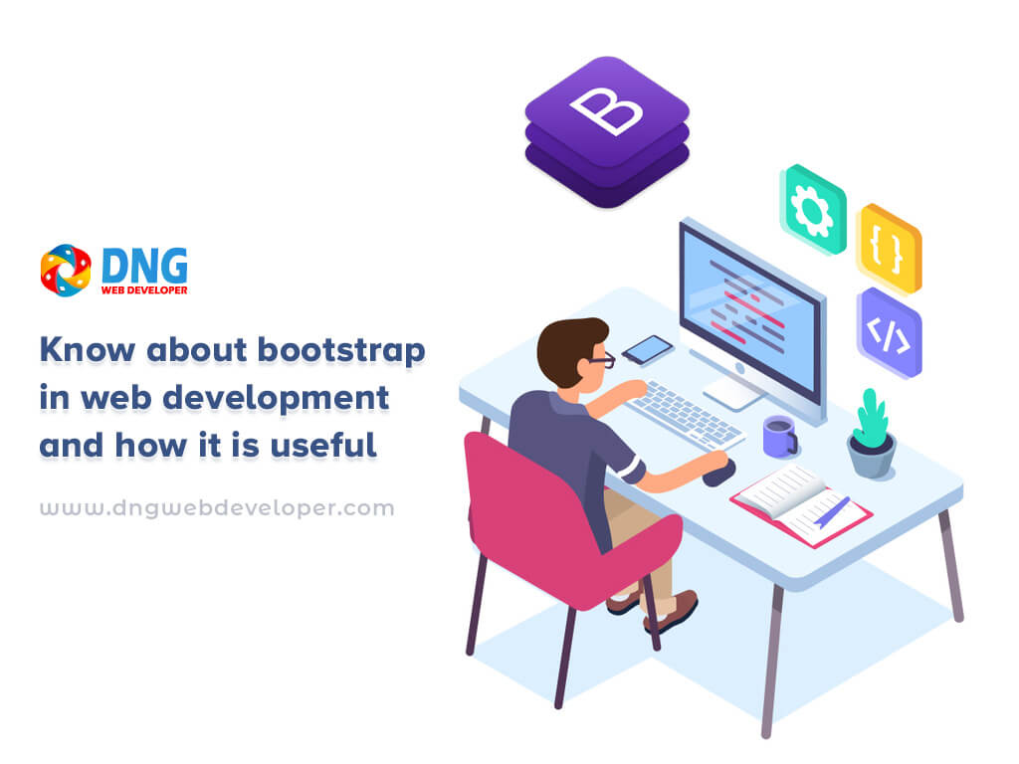
Bootstrap's Role in Future Web Development
Bootstrap is poised to continue as a leading framework for responsive web design and development.
Its adaptability to new trends and technologies, such as PWAs and AI, will ensure its relevance in the future.
Bootstrap's community-driven development model will likely lead to ongoing updates and improvements.
Notes:
Image source: https://www.dngwebdeveloper.in/know-about-bootstrap-in-web-development-and-how-it-is-useful/

Slide 11
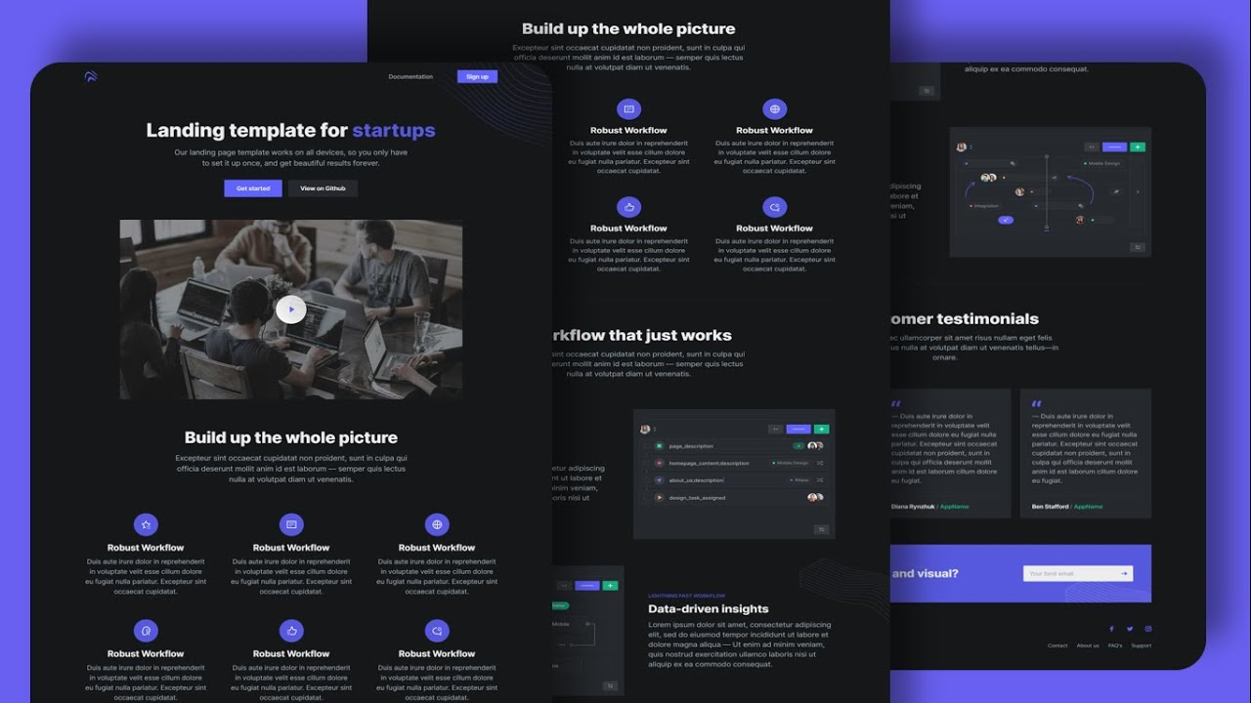
Conclusion
Bootstrap remains a valuable tool for developers seeking to create responsive and visually appealing websites.
Its latest version, Bootstrap 5, offers new features and enhancements that cater to modern web development needs.
By staying current with industry trends and user preferences, Bootstrap is positioned for a successful future.
Notes:
Image source: https://studypolygon.com/tutorial/create-website-using-html-css-bootstrap-complete-website-design-bootstrap-tutorial

Slide 12
References
GetBootstrap. (n.d.). Bootstrap. https://getbootstrap.com/.
Your second bullet
Your third bullet

